Slide 1
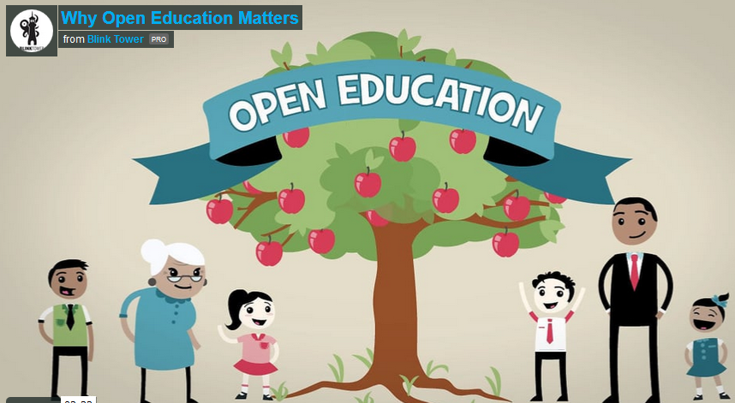

Slide 2
Openness in education
Concerns Open Educational Resources (OERs)
Education is sharing
Leveraging the Internet
The $5 textbook
Continuous quality improvement
Open access (academic publications)
Open teaching (open courses)

Slide 4
Open
Educational
Resources
OERs

Slide 5

Definition of OERs
“web-based materials, offered freely and openly for use and re-use in teaching, learning and research” (Joyce, 2007).
“teaching, learning and research materials in any medium, digital or otherwise, that reside in the public domain or have been released under an open license that permits no-cost access, use, adaptation and redistribution by others with no or limited restrictions”
(UNESCO Paris OER Declaration, 2012)
Joyce, A. (2007). OECD Study of OER: Forum Report, OECD. Retrieved December 12, 2011 from http://www.unesco.org/iiep/virtualuniversity/forumsfiche.php?queryforumspages_id=33.
UNESCO. (2012, June 22). 2012 PARIS OER DECLARATION. Retrieved June 13, 2013, from unesco.org: http://www.unesco.org/new/fileadmin/MULTIMEDIA/HQ/CI/WPFD2009/English_Declaration.html

Slide 6



























Slide 7

OERs – free to reuse
This presentation is reusing slides from an OER

Slide 8
The “O” in OER
The four ‘R’s model:
Reuse – the most basic level of openness. People are allowed to freely use all or part of the unaltered, verbatim work.
Redistribute – people can share copies of the work with others.
Revise – people can adapt, modify, translate, or change the form of the work.
Remix – people can take two or more existing resources and combine them to create a new resource.
Hilton, J., Wiley, D., Stein, J., & Johnson, A. (2010). The four R‘s of openness and ALMS Analysis: Frameworks for open educational resources. Open Learning: The Journal of Open and Distance Learning, 25(1), 37-44.

Slide 9
Increasing openness of the four ‘R’s: adapted from (Hilton et al., 2010)

Slide 10
Examples
Biology in elementary schools
Free and open courses (link to COP page)
The e-books in your collection (link to ebooks)

Slide 11

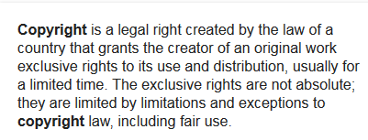
From Wikipedia (itself an OER)

Slide 12

Copyleft
In contrast, under copyleft, an author may give every person who receives a copy of the work permission to reproduce, adapt, or distribute it,
…with the accompanying requirement that any resulting copies or adaptations are also bound by the same licensing agreement.
(Wikipedia)

Slide 13




Copyright
Open Content Licensing (OCL) schemes:
Public Domain
Creative Commons (CC)
GNU Free Documentation Licensing
Other regional or institutional licenses
  BC Commons (discontinued)

Slide 14

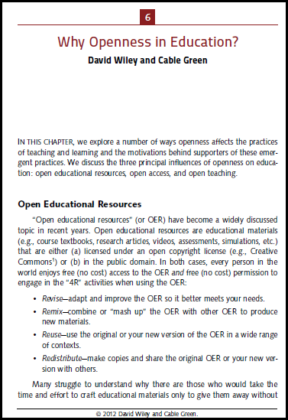

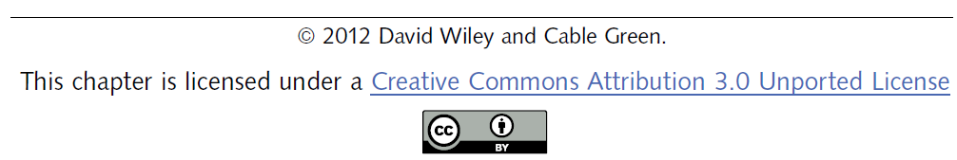
Creative Commons

Slide 15
OERs internationally
UNESCO
Commonwealth of Learning
Cape Town Declaration
Paris OER Declaration

Slide 16
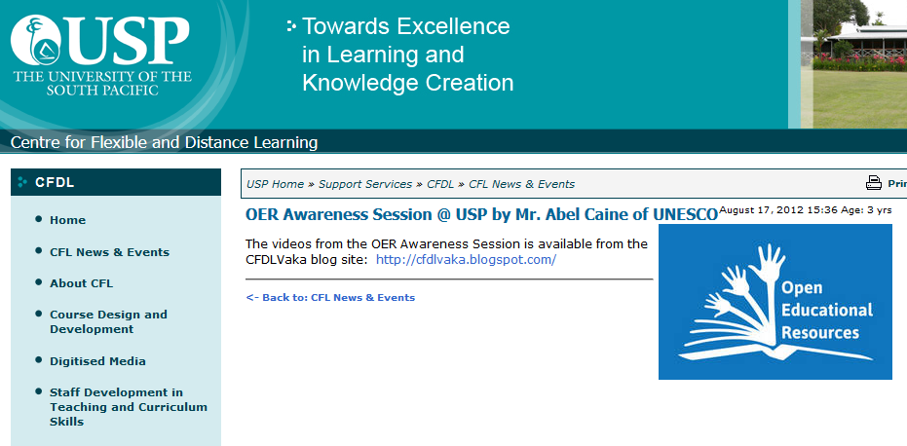
OERs in the Pacific Islands region
OER Foundation of New Zealand
USP

Slide 17
This morning’s session
Introduction to the educational resources provided on the gateway servers
Offline (locally stored, Internet not required)
Online (resources on the Internet)

Slide 18
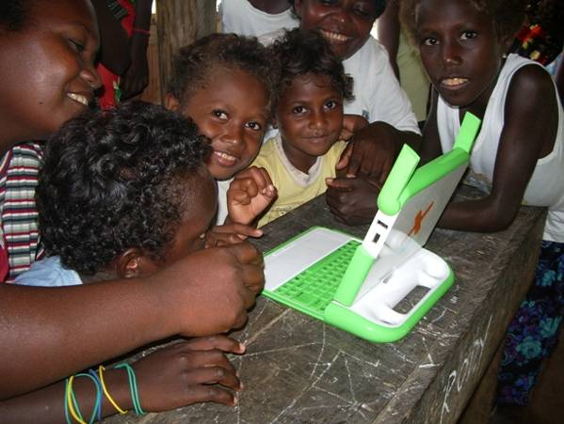
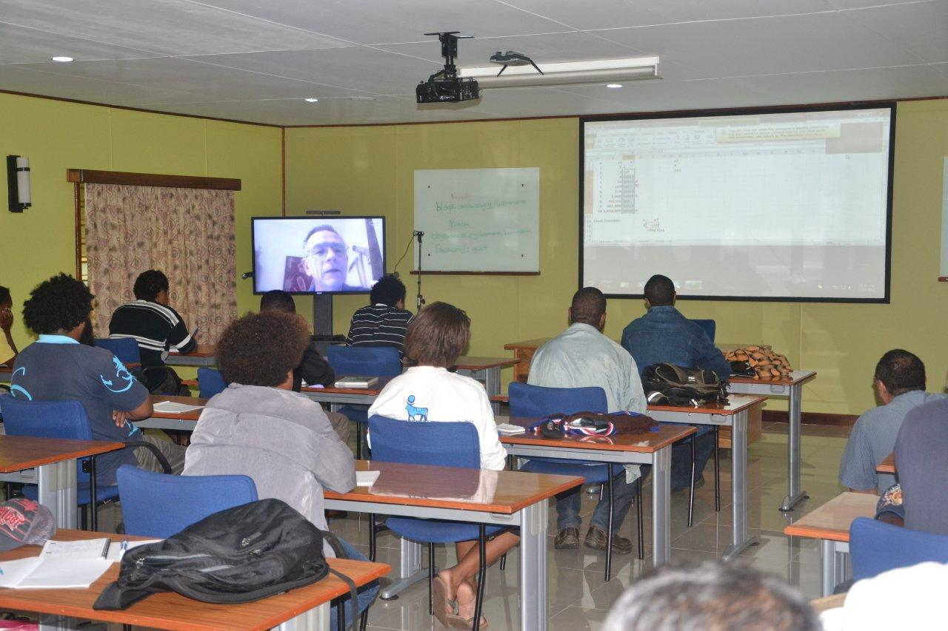
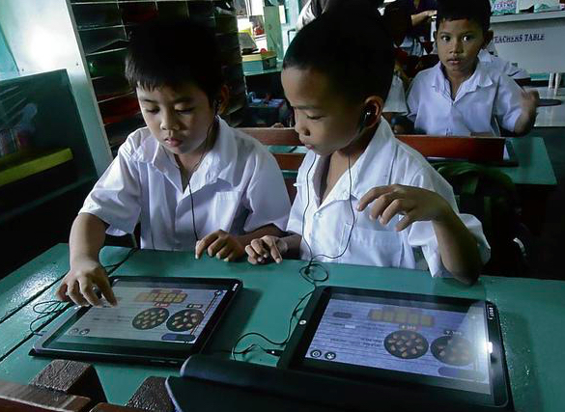
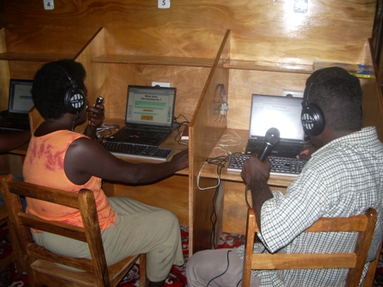
Thinking about using
ICTs for Teaching and Learning
Photo: DWU
Photo: ISIF Asia

Slide 19
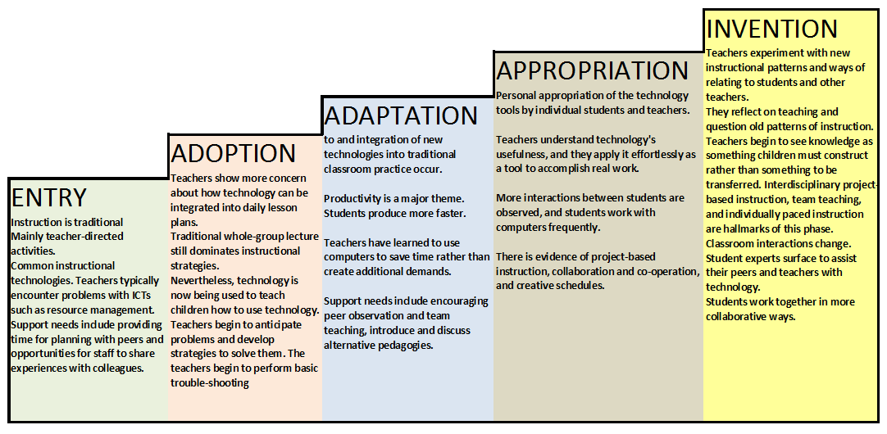
Five stages of ICT Integration
Technology cannot be integrated into classroom programs overnight.
Each stage has its own patterns of change and support requirements.
Ref: UTAS, from Sandholtz, Ringstaff, and Dwyer (1997)

Slide 20

Linking resources to the curriculum

Slide 21
Not just for information…
ICT can be
A tool for discovery learning
For creating, recording, producing
Visual aids : simulation and modelling
Engaging and interesting
Changing to more child-centred teaching

Slide 22
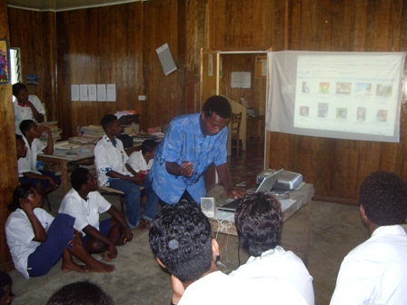
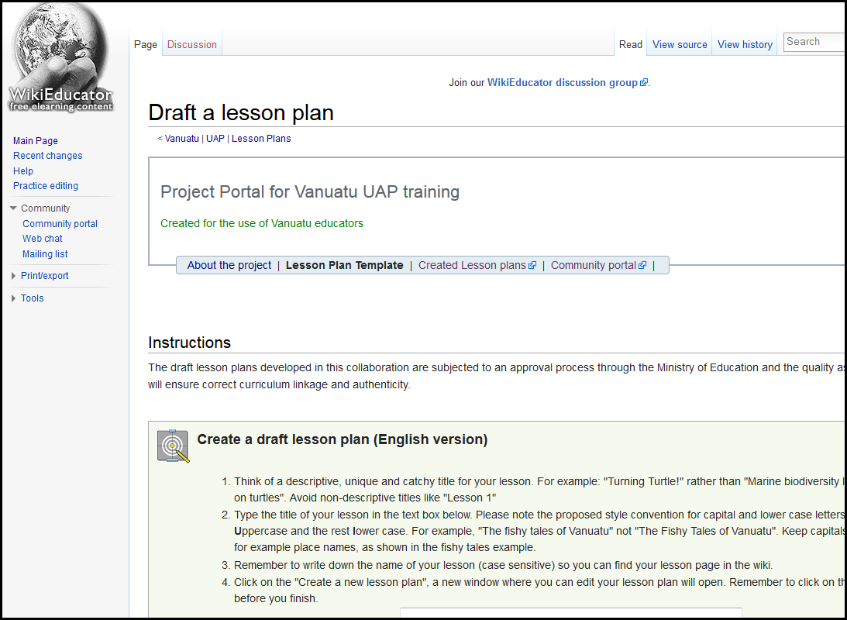
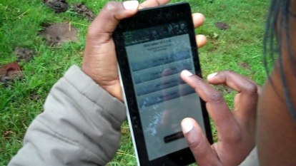
…. become partners in co-creating, enriching and reconfiguring the learning materials
….authentic and engaging learning assignments….

Slide 23
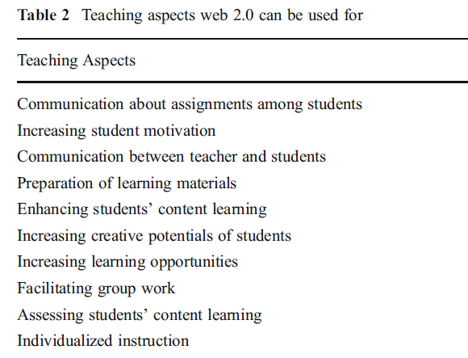
Teaching style, ICT experience and teachers’ attitudes toward teaching with Web 2.0
Ugur Kale & Debbie Goh, Educ Inf Technol (2014)

Slide 24

Content-area literacy teaching
Use ICTs to help students practice and develop their language skills in all content areas
Check grammar and Spelling
Presentation and
communication skills
Creative reporting
Pronunciation
Collaborative Writing
Visual communication

