Slide 1
Local Content
What? Why? How?

Slide 2

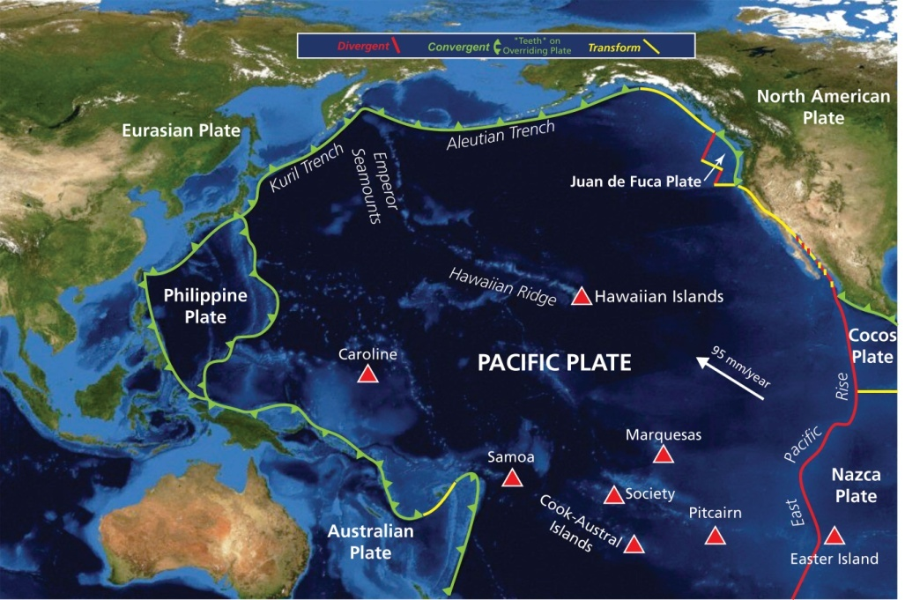
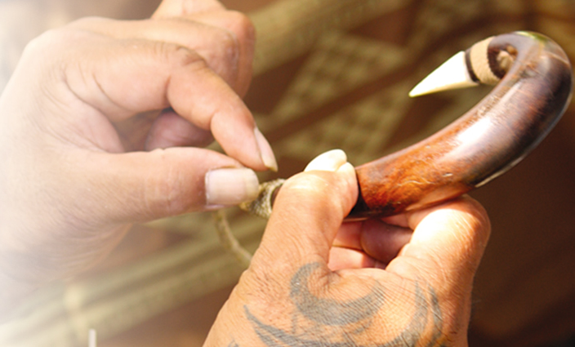
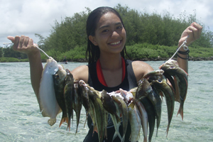
Shortage of appropriate digital content from/about the Pacific

Slide 3
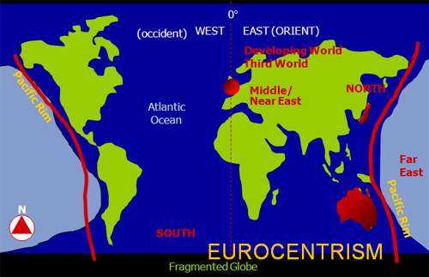

Slide 4
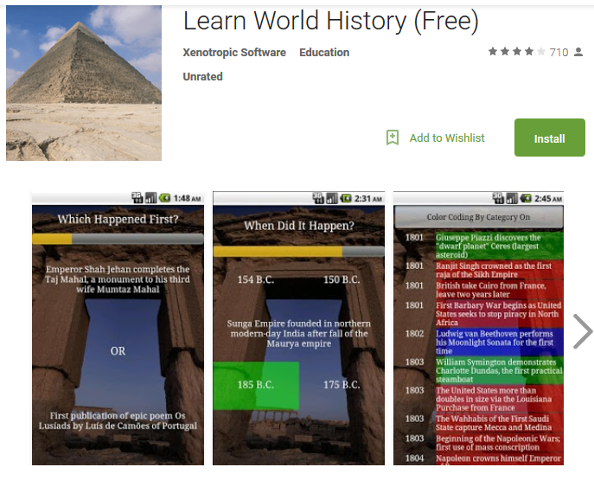

Slide 5
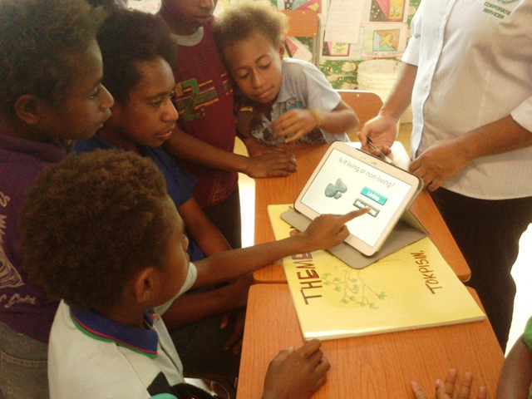
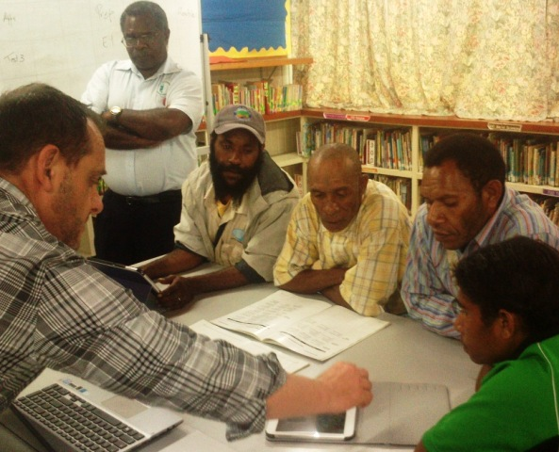
Designing curricular resource packs for Android tablets, to support the PNG elementary school curriculum and “Big Book” teaching method

Slide 6
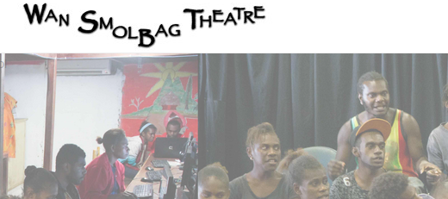
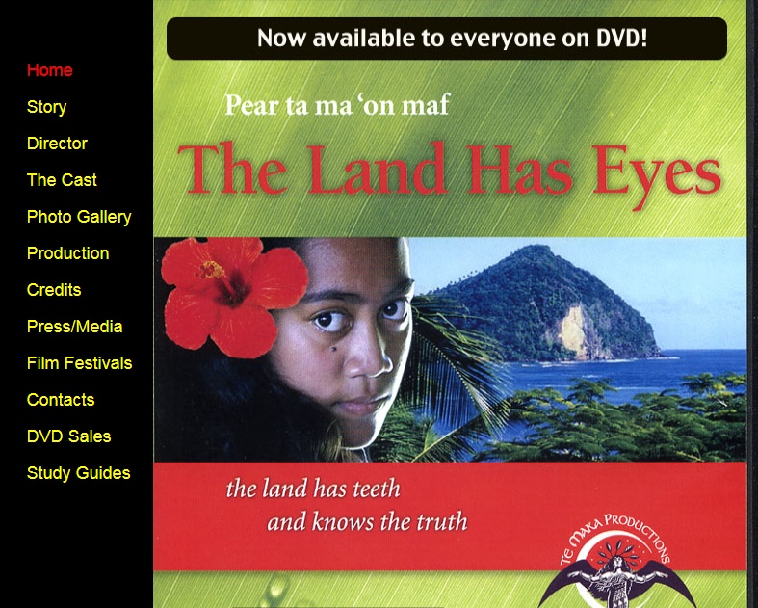
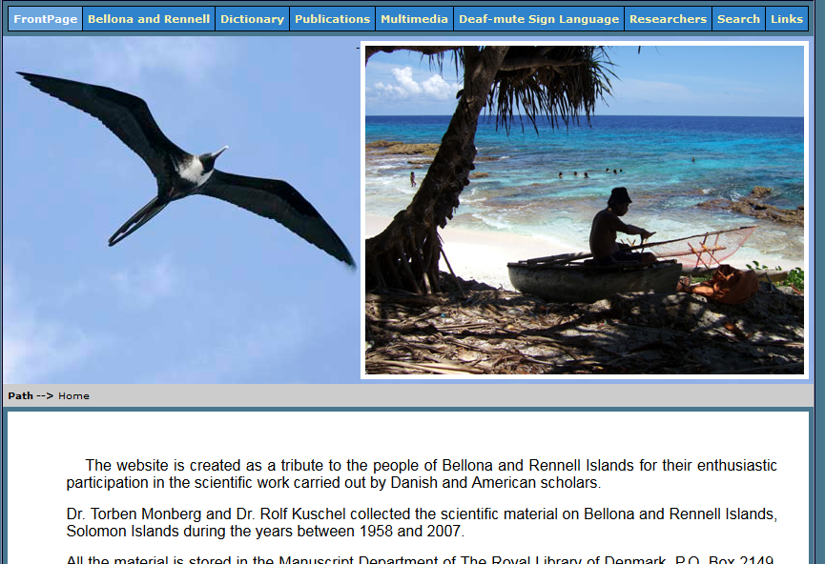
Culture and indigenous knowledge

Slide 7



Some regional partners for local content

Slide 8
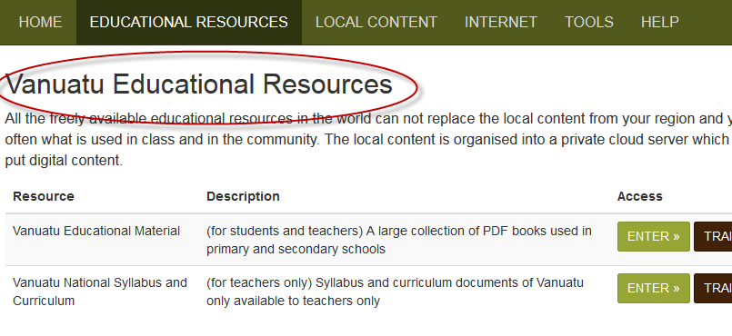
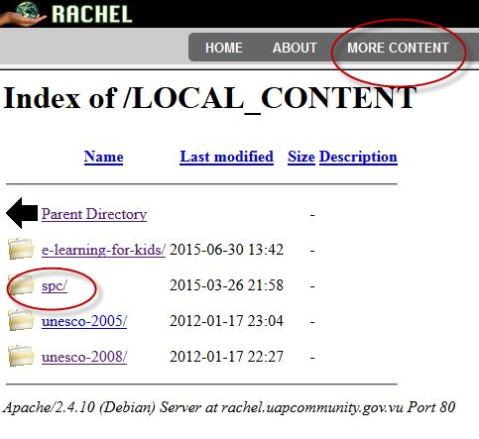

Slide 9
Culture and indigenous knowledge

Slide 10
Why local content
Need to look inwards as well as outwards
We are living at a time of advanced globalisation
ICTs and media powerful influences
Media culture often comes with “cultural baggage” of imported values and meanings
Becomes more important than ever for young people to study and appreciate their own cultures and values
ICTs are powerful enablers for creative, collaborative and participatory learning

Slide 11
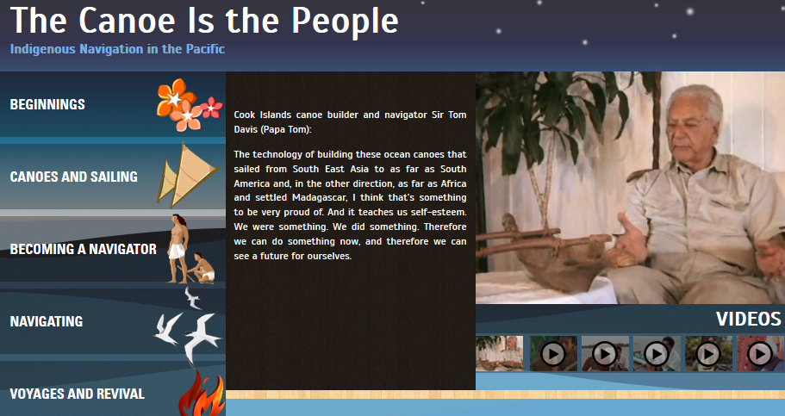
‘I think,’ says navigator Tua Pittman, ‘our children need to know
who they are and where they come from. So when they grow
up, they can talk about Karika and Tangiia first and then
Columbus later.
And that a lot of them
when they do grow up,
hopefully will look back
at us and what we do
and say thank you.
Thank you very much
for letting us know who
we are. That’s why we’re here.’
Wayfinders: A Pacific Odyssey, 1998
(quoted in the Teaching Guide to Canoe Is The People educational resource, UNESCO)

Slide 12



UNESCO - LINK project
Curricular resource “packs”
Aim to integrate indigenous knowledge into the curriculum
Digital resources developed using participatory methods
Schools and communities
Lesson plans, teaching guides, student books
?

Slide 13
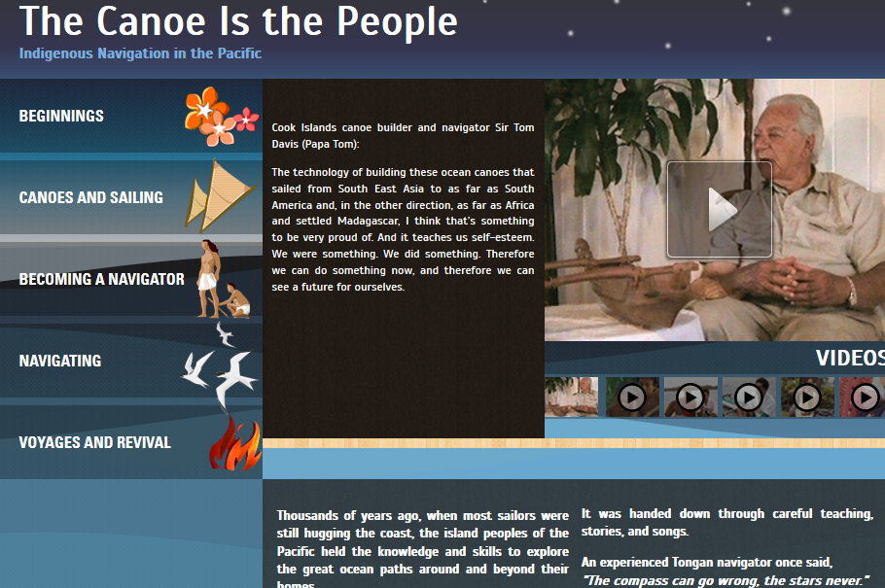
Canoe is the People

Slide 14
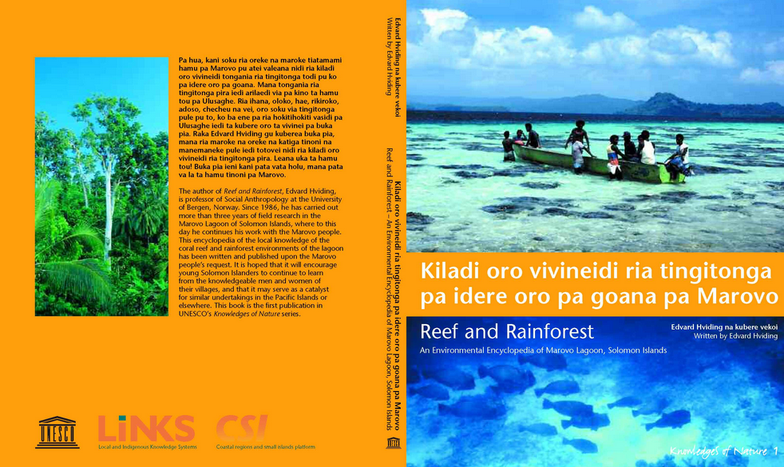
Marovo Reef and Rainforest, Solomon Islands

Slide 15
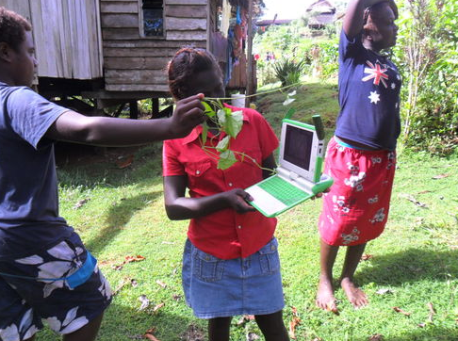
ICTs, media, culture
Media culture – young people need to learn media skills

Slide 16
ICTs, media, culture
Curriculum-linked activities where students study their local way of life and culture
  Ensure the transfer of indigenous knowledge and values to the new generations
  Can use and help to
  preserve indigenous
  languages
  Highly engaging and
  authentic for learning
  assignments

Slide 17
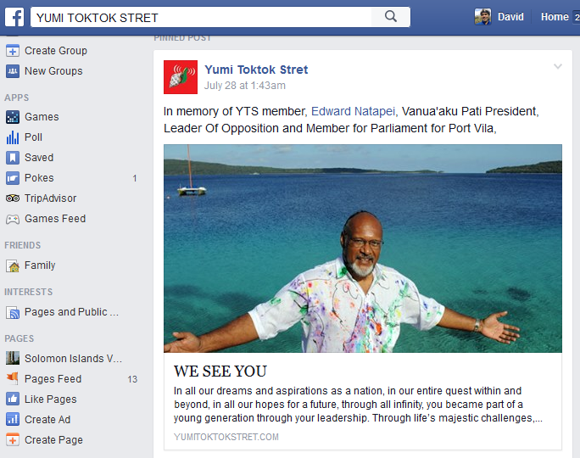
Modern literacies include the digital and the visual

Slide 18


Slide 19
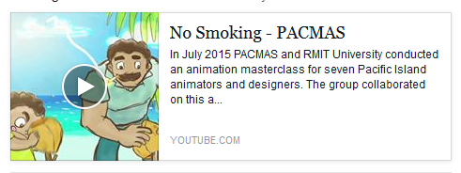
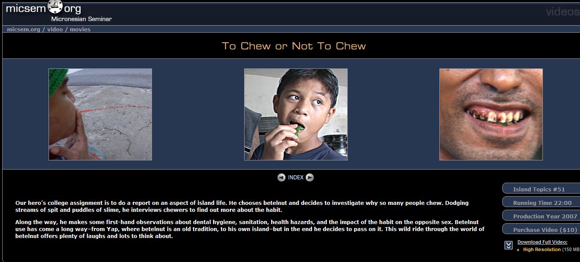
Modern literacies include the digital and the visual

Slide 20
Local content means local production
An essential ingredient in "local content" is the participation of learners in its production
Students can partner with each other, with their teachers and even with their communities in the co-creation of educational content.

Slide 21

Another highly relevant theme linked to the curriculum

Slide 22
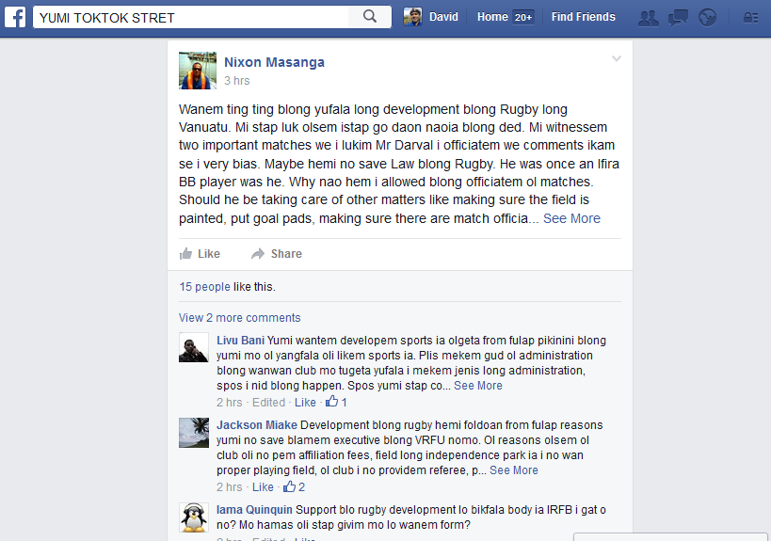
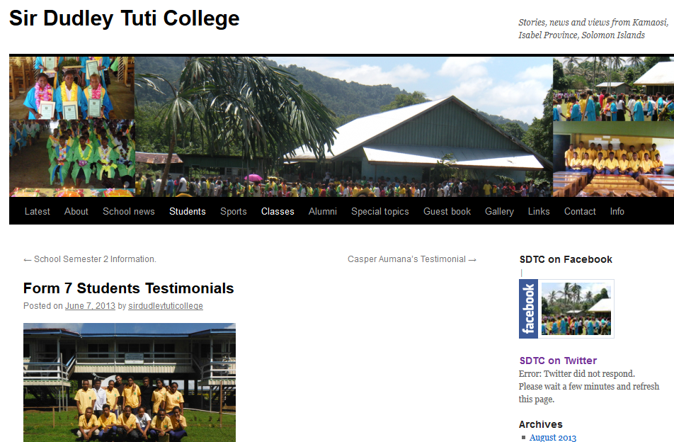
Civic engagement
Learning to be an active citizen
The skills to participate through the media
The attitude – claiming the right to participate

Slide 23
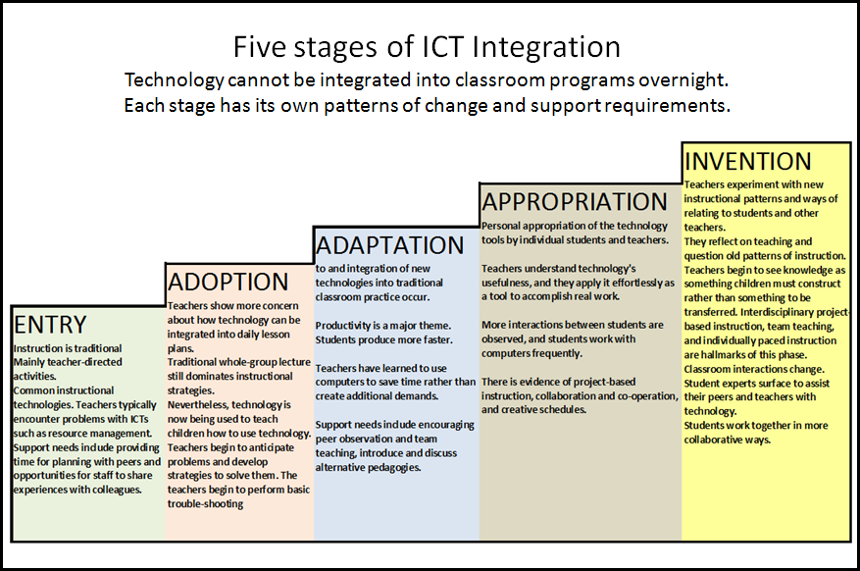
These things take time!
teacher training
curriculum development
policy development

Slide 24
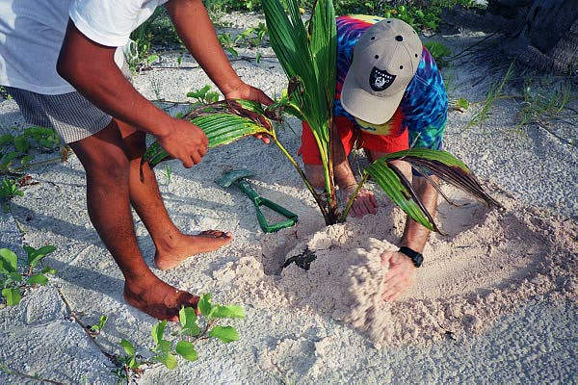
But we can plant a few seeds…

Slide 25
Local Content Part 1
Creating websites
Create a personal blog website with Wordpress
Learn to add posts (articles)
Learn to add images
Learn to personalise and manage your site

Slide 26
Local Content – Part 2
Review of two UNESCO collaborative content development projects in the Pacific
Wiki skills : Learn basic wiki skills and attitudes for collaborative local content development

Slide 27
Local content Part 3
Multimedia editing
Image editing using GIMP
Audio editing using AUDACITY
Record and edit video
PowerPoint will be included in ECF training tomorrow

Slide 28
Local Content
Afternoon Projects
Create a School Website with Wordpress
More wiki skills training, set up a local language wiki on the school portal
Multimedia training – recording and editing images, audio, video

