Slide 1
Local Content – Part 2
See what Vanuatu Government and stakeholders say about the importance of local content
Review of two UNESCO collaborative content development projects in the Pacific
Wiki skills : Learn basic wiki skills and attitudes for collaborative local content development

Slide 2
Vanuatu’s ICT Policy
Download from the topic resources
Read page 63

Slide 3
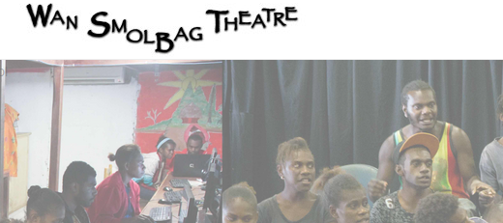
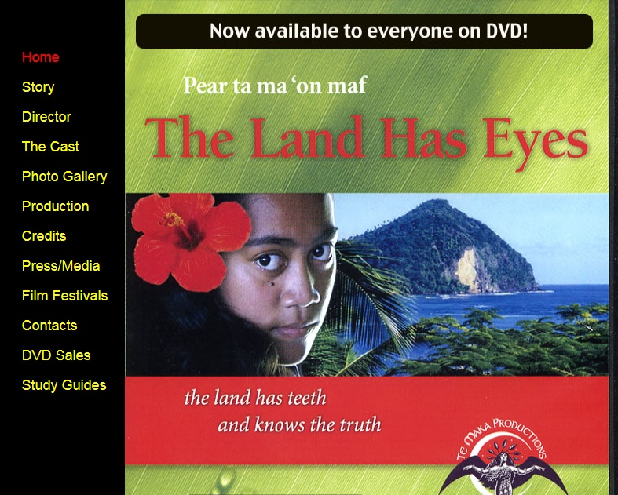
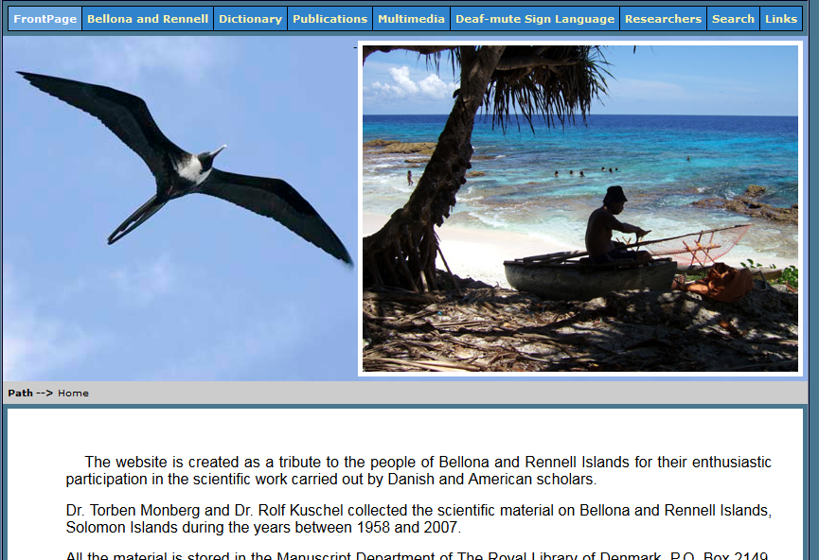
Culture and indigenous knowledge

Slide 4
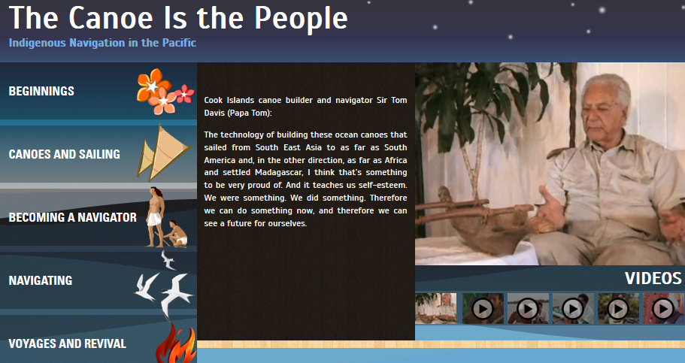
‘I think,’ says navigator Tua Pittman, ‘our children need to know
who they are and where they come from. So when they grow
up, they can talk about Karika and Tangiia first and then
Columbus later.
And that a lot of them
when they do grow up,
hopefully will look back
at us and what we do
and say thank you.
Thank you very much
for letting us know who
we are. That’s why we’re here.’
Wayfinders: A Pacific Odyssey, 1998
(quoted in the Teaching Guide to Canoe Is The People educational resource, UNESCO)

Slide 5



UNESCO - LINK project
Curricular resource “packs”
Aim to integrate indigenous knowledge into the curriculum
Digital resources developed using participatory methods
Schools and communities
Lesson plans, teaching guides, student books
?

Slide 6
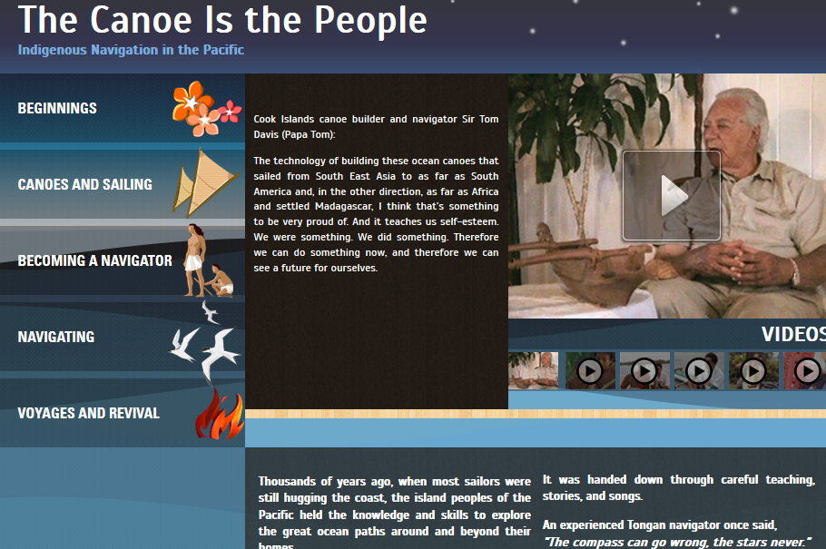
Canoe is the People

Slide 7
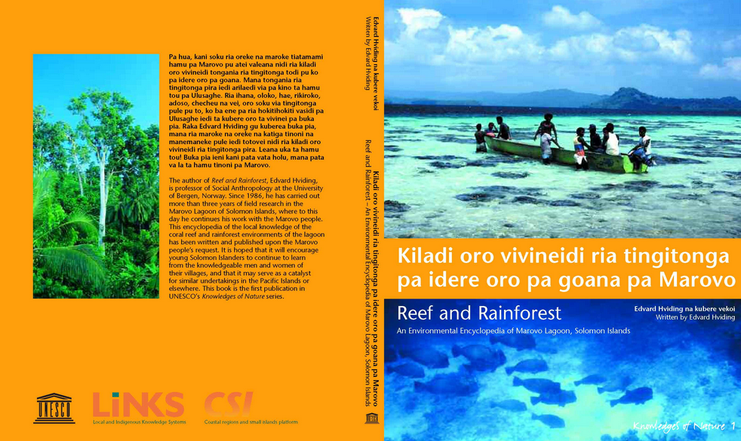
Marovo Reef and Rainforest, Solomon Islands

Slide 8
Practical
Explore the UNESCO resources
Teachers guides.
Group exercise
  Explore Wikipedia (English, French, Bislama)
  Sign up to the Wikipedia (Bislama)
  Sign up to Wikieducator and edit your user page
  Share a lesson plan using a template on Wikieducator
  Afternoon project for those who want to learn wiki skills and start Wiki pages for your school and Bislama

Slide 9
What is a Wiki?
Wikipedia www.wikipedia.org
  English French Bislama
Wikibooks www.wikibooks.org
  Guide to Managing Telecentre Networks
WikiEducator www.wikieducator.org
  Learn basic skills and attitudes for collaborative local content development

Slide 10
Wikieducator Tutorial
A fully inclusive training course
How to use Wikis from basics to advanced
http://wikieducator.org/Wikieducator_tutorial
Digital Skills for OERs (free guided courses)

Slide 11
Practical
Group exercise
  Explore Wikipedia (English, French, Bislama)
  Sign up to the Wikipedia (Bislama)
  How could you use this resource in T & L ?
  How can you involve students and community?
  Sign up to Wikieducator and edit your user page
  Share a lesson plan using a template on Wikieducator
  Afternoon project for those who want to learn wiki skills and start Wiki pages for your school and Bislama

