Slide 1
Moodle @ USP
Pita Tuisawau
Instructional Designer
Centre for Flexible Learning
With thanks to Professor Don Paterson, Aidan Ricketts & Helen Menard

Slide 2
Content
What is Moodle: video
Moodle is teamwork
Moodle@USP is 3 Systems
How does USP use Moodle?
  Support F2F teaching
  Blended learning
  Online Mode
  Training
  Community of practices

Slide 3


Moodle@USP
Involves the following Teams
Learning systems team: maintain Moodle servers
ITS
Maintain infrastructure
Services, Labs & computers
Teachers: Design, develop & facilitate learning & Teaching
CFL
Course Design
Training

Slide 4



Moodle@USP
Moodle at USP comprises two other systems

Slide 5

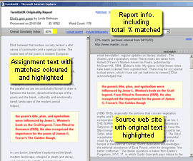
Turnitin
Online plagiarism tool
  shows how your students may have inappropriately used or referenced source material.

Slide 6
Mahara@USP
Mahara is the University's e-Portfolio system.
Example: Peniana Patrick Ni-Vanuatu agricultural student in Alafua

Slide 7
How does USP use Moodle?
  Training/Workshops
  Support Community of practices
  Support for F-2-F teaching
  Facilitate Blended learning
  Facilitate fully Online mode

Slide 8
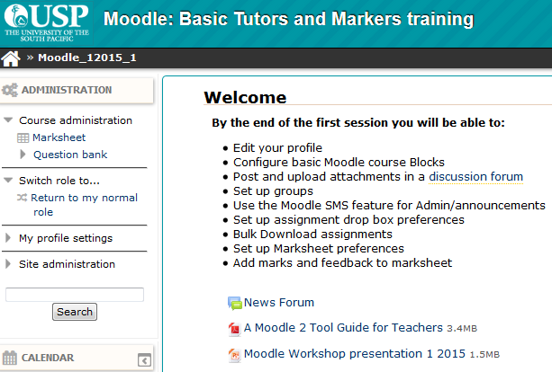
How does USP use Moodle?
Support Training & Workshops

Slide 9
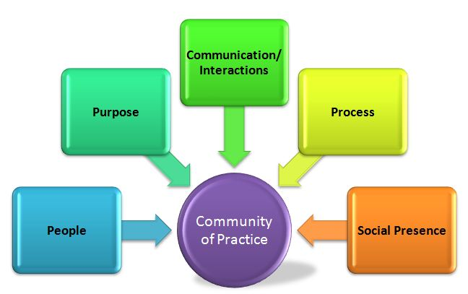
How does USP use Moodle?
Support Communities Of Practice

Slide 10
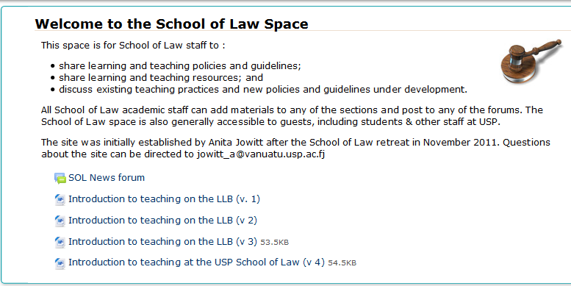
How does USP use Moodle?
Support Communities Of Practice

Slide 11

  Facilitate fully Online mode
LW392: Civil Procedure
  Lecturer: Dr Helen Menard
  Earned High reviews from Flexible Learning Review
  team
Innovative use of simple forums and groups to transfer her past law practice experiences into virtual Law firms and Court Registries
  Rationale: to bring dry boring topic to life and to target best learning medium: Learning by doing

Slide 12

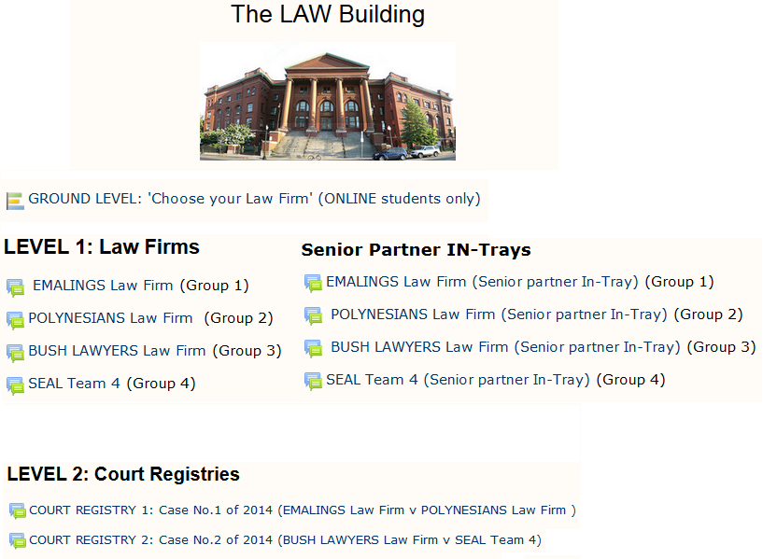

Slide 13
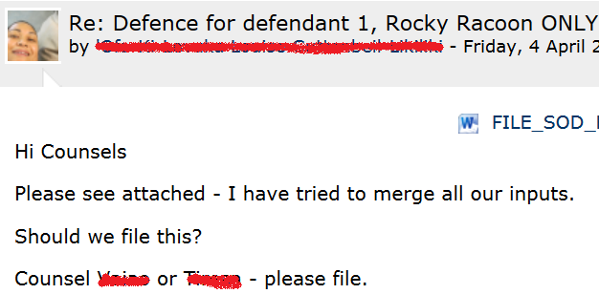
VIRTUAL LAW FIRM: Student interaction with student & Content

Slide 14
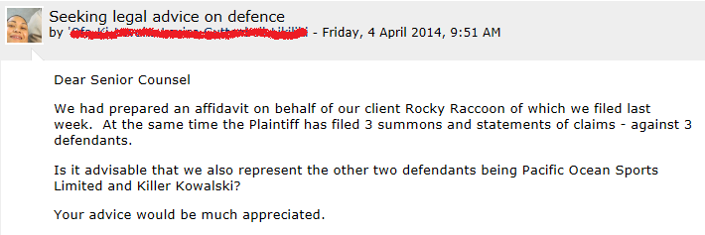
SENIOR PARTNER IN-TRAY: Student – Teacher Interaction

Slide 15
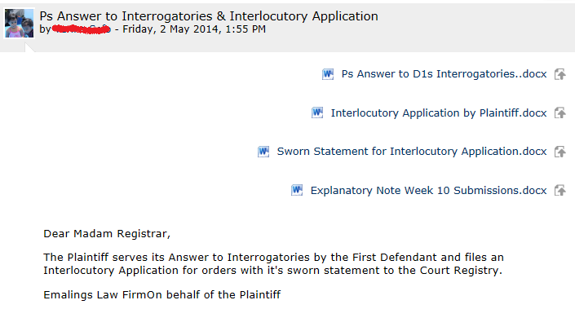
COURT REGISTRY: Student-Content-Teacher interaction

Slide 16
Did the students learn?
Student feedback B: “I don't understand why this isn't a compulsory paper - because I believe it should be. It gives a great mix of both practical and theory.”
Student feedback C: The assessment program (court visit/law firm groups) was enlightening because it offered a practical insight to the procedures of civil courts. My only negative comment would be the communication difficulties experienced by groups such as ours, whose members were located on different campuses. Not everyone has the luxury of frequent access to online communication. However, on a positive note, our group formed an amicable relationship, even though we have not met personally.
Notes:
Authentic assessment (positive feedback)
High Interactivity: Student-Content-Teacher
High Teacher online presence
Fruit of sharing of teaching practice

Slide 17

  Facilitate Blended learning: LW352
Mode |  | Activities
Online (79%) | Weeks 1-13 | Group work written
F2F (21%) | Week 14 | Oral advocacy presentations
Aim: equip students with the information and skills to evaluate and critique different environmental regimes in context.
The group presentations required students to role play a plausible professional setting
  government advisors
  community activists
  consultants
  environmental lawyers
  NGOs
  business forums

Slide 18
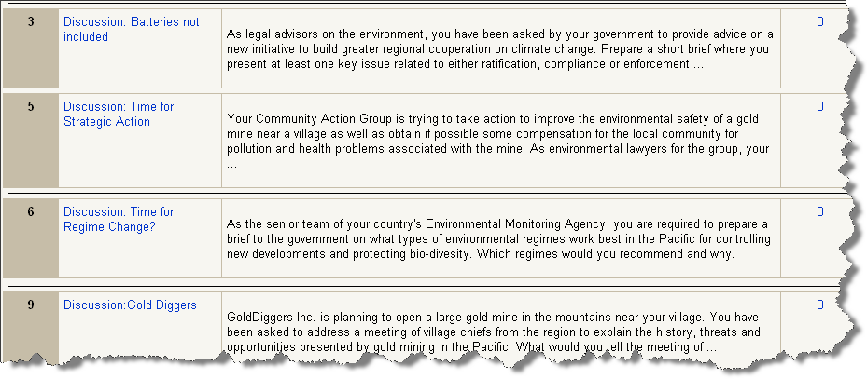
Forum group tasks
AUTHENTIC
PRACTICAL
COLLABORATIVE

Slide 19





1. Students choose their groups from 12 options (Weeks 1-2)
2. Law firm forums: to prepare their presentation/brief
3. Weekly Presentation forums where Firms presented to the rest of the firms and were critiqued by peers.
4. Coordinator marks the weekly group presentation and provides feedback that takes into account key peer contributions.
Notes:
Once students chose a group they were automatically enrolled in “group working forums” which were closed to all students outside the group
These forums became like a workshop/Law firm in which the students could collaborate in privacy
Once the final presentation was prepared students would then share it on a forum accessible to all students
Archecture
The general body of students could then comment, question and interact

Slide 20
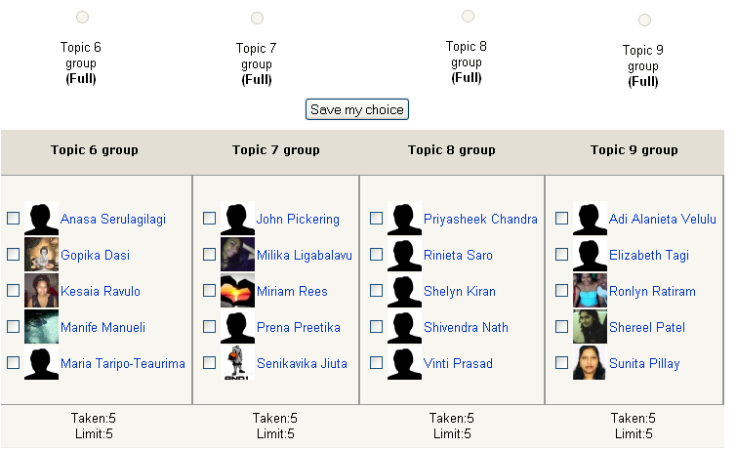
Choice moodle page

Slide 21
Student response
The single most amazing outcome of the new course design was the enthusiasm and professionalism of the students:
  High quality presentations
  Relevant research sometimes field research
  Highly engaged feedback from other students following presentations

Slide 22
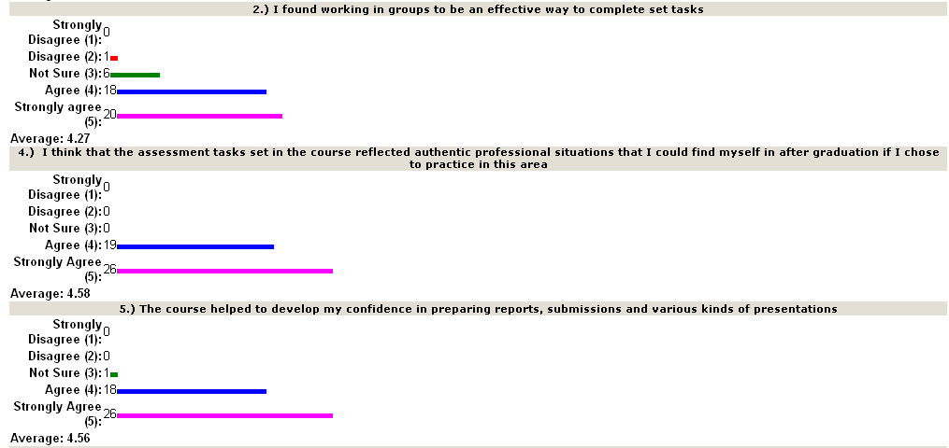
Student feedback

Slide 23

Comparison of academic results between DFL and F2F cohorts
In the 2009 academic results for LW352 BOTH F2F and online students scored well
the online cohort marginally outperformed the F2F cohort in grades of B+ and above. (50% against 48%)
The highest achieving student was a lone Alafua online student
These results overturned the usual trend for the SOL where online/DFL cohorts routinely underachieve in most courses

Slide 24

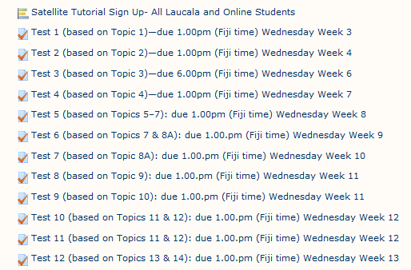
  Support for F-2-F teaching: LW300
Weekly Scenario-based Multiple Choice Tests
Course coordinator: Prof. Don Paterson

Slide 25
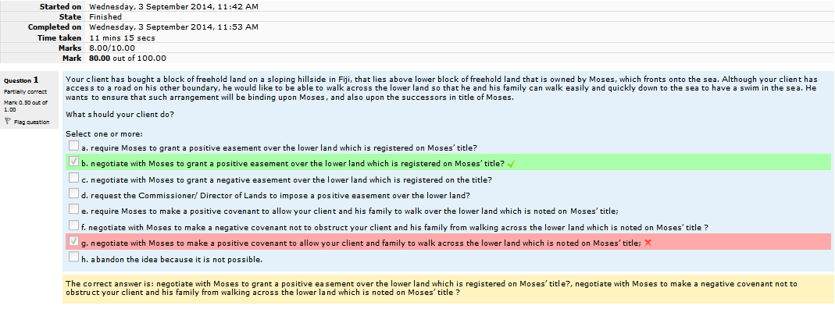
A marked online Test (Test 5)
Correct answer
Wrong answer
Feedback

Slide 26



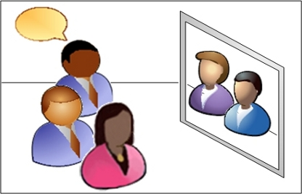
FEEDBACK IS KEY FOR MCQs
Learners need prompt feedback to learn effectively (Gibbs, 2007). In a meta-analysis of studies into student achievement, feedback was reported to be the single most powerful influence (Hattie, 1987)
Moodle question bank & Marksheet
F2F Tutorial for Oral Feedback
Video-Conf Tutorial for Oral Feedback

Slide 27
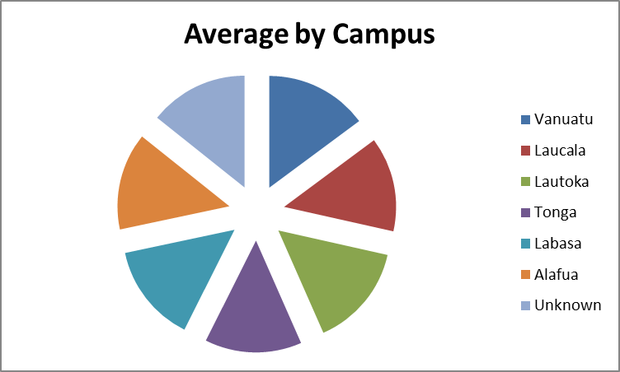
LW301 Online Test Results
2-2013
Campus | Average
Vanuatu | 22.93
Laucala | 21.17
Lautoka | 23.03
Tonga | 21.62
Labasa | 22.07
Alafua | 21.75
Unknown | 22.07

Slide 28
Student Evaluation
Responses | Agree | Strongly agree | Not sure | Disagree | Strongly disagree | Total
I read the Topic notes to help me prepare for my weekly tests. | 27 (36%) | 47 (64%) | 0 | 0 | 0 | 74
I try to listen to the lecture recordings to help me prepare for my tests. | 38 (51%) | 26 (35%) | 3 (4%) | 6 (8%) | 1 (1%) | 74
I learn a lot from the feedback and discussions on the tests given in the tutorials. | 25 (34%) | 42 (57%) | 4 (5%) | 2 (3%) | 1 (1%) | 74

Slide 29
Student feedback:
The best features of the course
“The online quizzes made learning interesting”
“Weekly online tests are very helpful”
“...i think that this unit has done a great work in engaging students on weekly tests rather than weekly postings, as this has encouraged students to read through and study the course materials thoroughly prior to the test. Students are able to assess their level of understanding the weekly topics through the test results....”
Notes:
16.33
7.08
13.32

Slide 30

Student feedback: Improvements to be made
“Ensure the answers to quiz are correct”
“Internet problems at Emalus greatly affects our online tests”

Slide 31
Summary
Moodle as a free LMS with a wide array of tools has served USP’s purposes very well for Online, Blended & F2F students and teachers
Good online course design can close the gap between F2F & Online students
F2F students’ experiences can be enhanced by online activities in Moodle
Staff & Students benefit from Fruit of sharing of teaching practice in the communities of practice, workshops and training that can be facilitated in Moodle
Some students & campuses still face challenges in their use of Moodle because of issues with bandwith, computer labs, wifi and computers.

Slide 32
Thank you for listening
Questions

