Slide 1


ONLINE/ DISTANCE LEARNING
EDWARDS COMPUTER FOUNDATION
Getting you through the New Millennium with the new techniques in Information and Communication Technology
01

Slide 2
Table Of Content
01
02
03
Vision and
Mission
History
About us
04
05
06
Courses Offered
Online Learning
Contact us
02

Slide 3

About us
Edwards Computer Foundation (ECF) is the training and development arm of Computer Network Services (CNS) that was established and registered with the Ministry of Education in 2002. Edwards Computer Foundation brings together the resources, skills and personnel of CNS and ECF Information Technology Management. It is 100% purely Ni- Vanuatu owned Information Technology training Centre and the head office is located in the heart of Port Vila city , in Vanuatu, South Pacific.
We have two training centres. One in Port Vila and one in Luganville Santo.
03

Slide 4
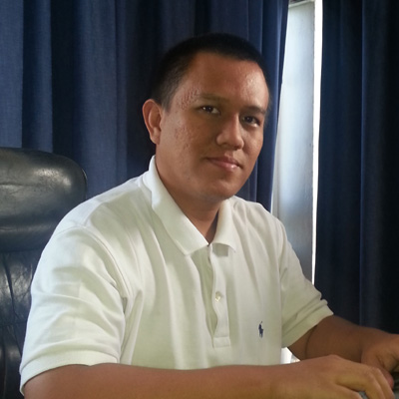

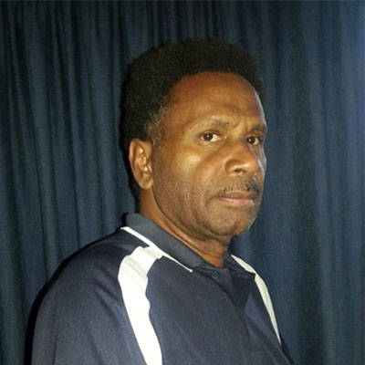
Management Staff
Joseph Edwards Tamata
Kris Triyantio
Sharon Stephens
OWNER/GENERAL MANAGER
Technical Manager
Training Manager
04

Slide 5
Vision And Mission
Our Vision is to be Vanuatu Premier Information Technology (IT) Training Centre and to expand the scope of our training into the Pacific island region.
Vision
Our Mission is to provide the highest standard of service to our clients/customers and trainees. We will ensure that our training is always:
Professional -> Focused -> Complete and -> To our clients and trainees needs.
Above all these ECF wants to provide quality, affordable and up to date IT training program to equip individuals with appropriate Information Technological knowledge and skills for future job prospects.
Mission
05

Slide 6
History: Past-Present
2002
2008
2012
Online training (First of its kind in Vanuatu)
-Registered with VNTC as Training Provider
-Started the certificate courses
Student taking further studies at NZPTC (Fiji)
2014
Online training started in ECF Santo
2005
2011
2015
Diploma Courses
New Intake for AMA courses
Introduction to PC Kids structure
Advance Diploma course started
06

Slide 7
Future
To open Partnership with other university around the Pacific and other countries (AMA University Philippines, Gunadarma University Indonesia)
ECF wants to provide quality, affordable and up to date IT training program to equip individuals with appropriate Information Technological knowledge and skills for future job prospects.
For Edwards Computer Foundation to become a private University for Information and Communication Technology in Vanuatu
07

Slide 8
Courses Offered
PC Kids & Junior IT Course
One year courses
Short courses
In house Training
New Structure for Classes 1 – Year 12
Certificate & Diploma Courses
Short courses – skills upgrading.
Trainings delivered at workplace based on training needs.
Rural Trainings
Trainee Work placement
Offering trainings in the communities based on needs identified
Trainees engaged in short term work placements for practical & theory skills
08

Slide 9
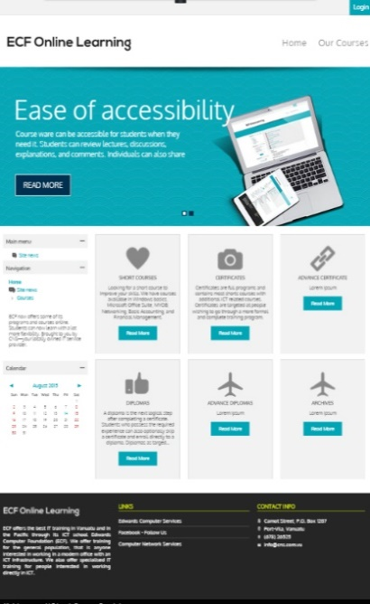
Online Learning
Schedule Flexibility
Ease of accessibility
Students can access their course at any time, from anywhere they can log in, in most cases.
Courseware can be accessible for students when they need it.
Students control study time
Lower total costs
Online programs can be a more affordable option than traditional colleges
Students may not have to sit for long periods of time.
More comfortable learning environment
Convenience and flexibility
Students will not have to fight traffic, find parking spaces, leave work early to go to class, or miss important family time.
Online courses give students the opportunity to plan their study time around the rest of their day, instead of the other way around
09

Slide 10
Process
After get the username and password, you can open http://learning.cns.com.vu. Click 'login' at the top right, and fill with your new user and password.
Register and pay the fee at ECF Vila/Santo to get access for the ECF online learning.
01
02
After login you will get inside online learning and automatic will give subject that you register in the earlier.
03
Before you can start to study and finish your exercise, you should change your password and update your detail.
04
On every subject there will be few topic that you can start to learn and also will have few exercise
05
06
Every submission you can upload or fill in directly inside ECF Online Learning.
Also there will be message and forum that every student able to share their knowledge and discuss with your teacher.
07
Every submission your teacher will check and give you grade that you able to see it and update your submission if your teacher allow.
08
10

Slide 11
Contact Us
If you need any further assistance or have queries please do not hesitate to contact us.
Mail
Phone
info@ecf.com.vu
or
ecf@cns.com.vu
+678 26525
Or
+678 7720853
/5475263
11

Slide 12
THANK YOU
THANK YOU FOR YOUR attention!
12

