Slide 1
Schooltool
Student Information System

Slide 2
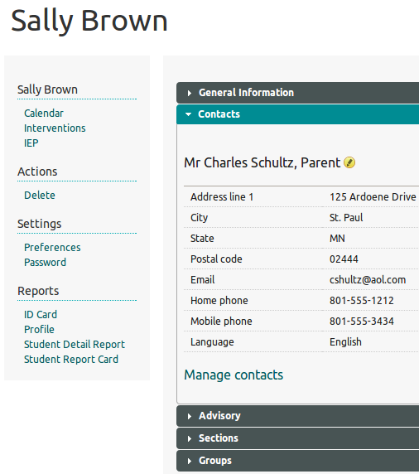
What is a School Information System?
Student records
  Phone Numbers
  Class lists
  Grades
  - more…

Slide 3
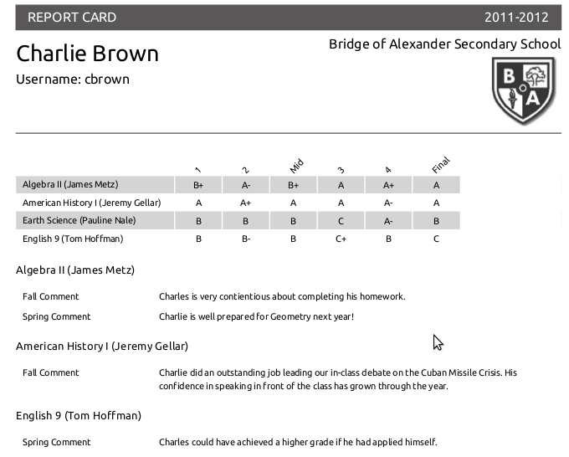
Report Cards
Automatic
Grades
Teacher Comments

Slide 4
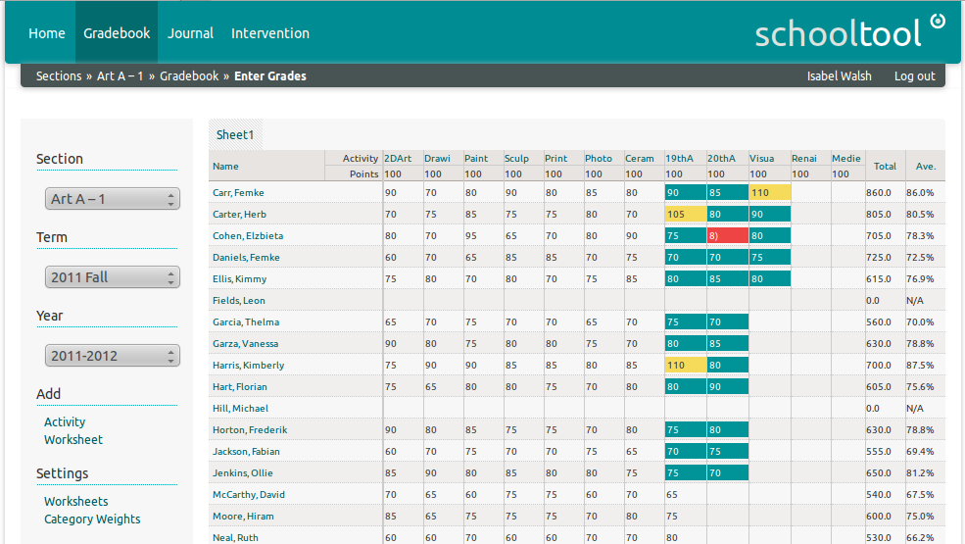
Teacher Grade Book

Slide 5
Additional Uses
Behavior Monitoring and Evaluation
Managing Interventions/Counseling with students and parents
CanDo Skill Tracking
Demographic and Personal Data
Daily Participation Journal
Calendars for the whole school or individual groups

Slide 6
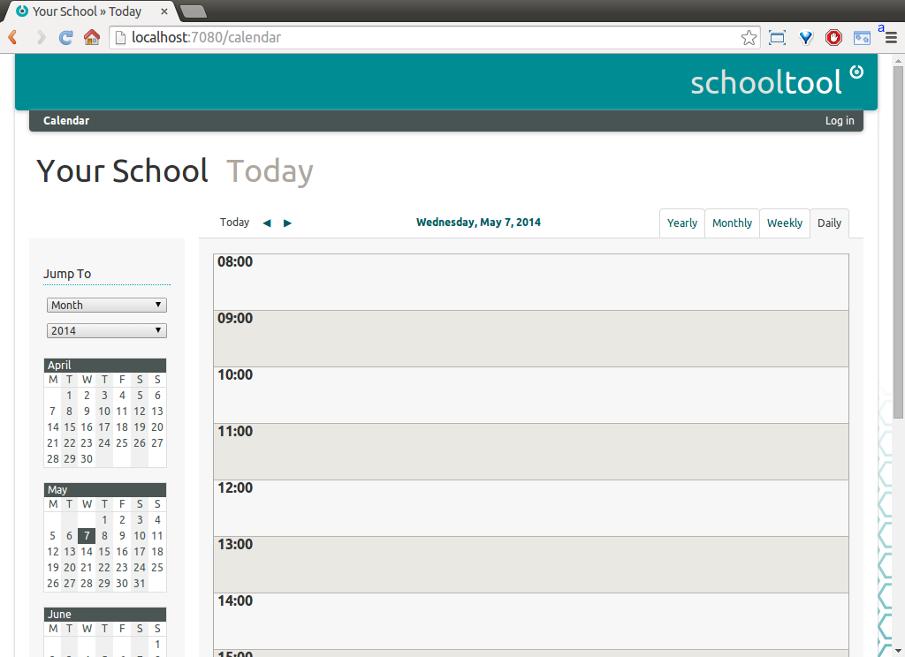
Username: manager
Password: schooltool

Slide 7
Populate the Database
Put all your students, teachers, and courses into the system

Slide 8
1st Create Years
“School” tab > Add School Year > Define the current school year’s start and end days
  Start: Feb 1st
  End: Nov 30th
Already Completed

Slide 9
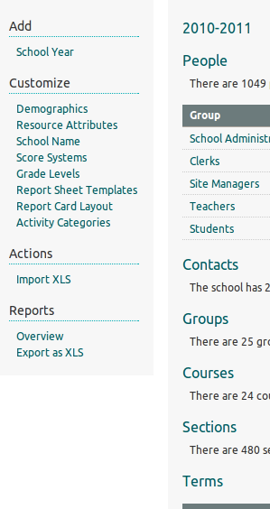
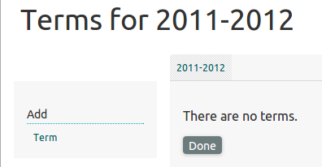
2nd Create Terms or Semesters
Basic: Create a “term” for each report created within the year
  Term1: Feb 1st – June 30th
  Term2: July 1st – Nov 30th
Already Completed
1
2

Slide 10
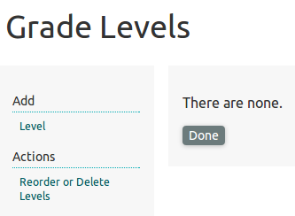
3rd Grade Levels
Add student years (grades)
  Year 7, 8, 9, 10, 11, 12 …
1
Already Completed
2

Slide 11
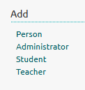
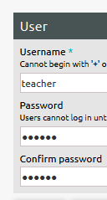
Adding People
1
Add one Teacher (you)
  Use your username and password uap123
2
3

Slide 12
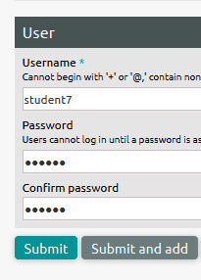
Adding People
1
Add a student
  Add them to a
  Year
2
3
Allows you to add multiple students in a row

Slide 13

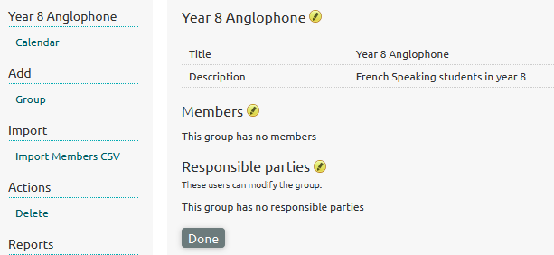
Adding Groups
3
2
1

Slide 14
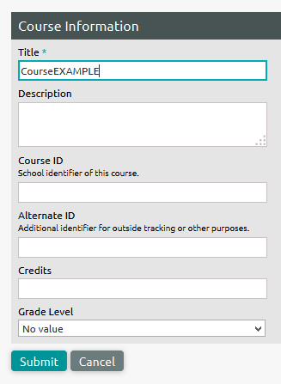
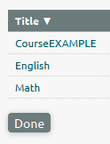
Adding Courses
Courses are the subject being taught
  Examples: English, Maths, Biology…
1
2

Slide 15
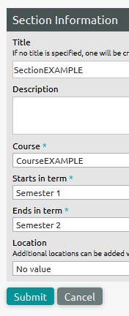

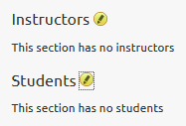
Adding Sections
One course has many sections
  Example: Year 7 Math, Year 8 Math
4. Set YOU as the instructor
2
5
1
3

Slide 16
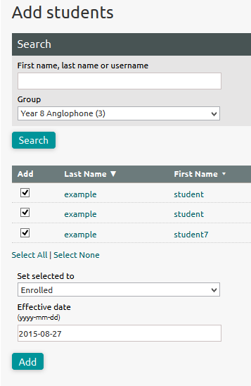
Adding Sections
6
7
5
8

Slide 17
Making Report Cards
Login with the “teacher” account you created earlier

Slide 18
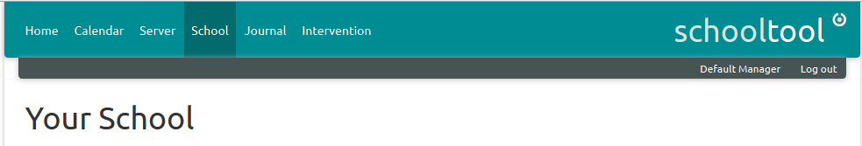
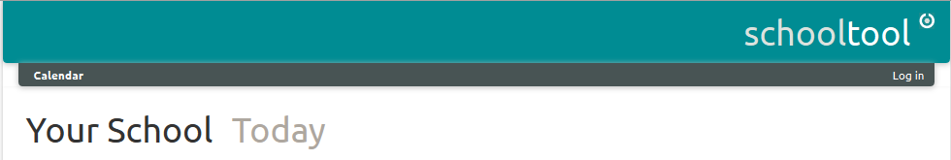
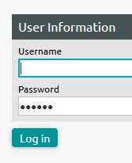
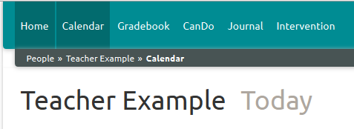
Login as a Teacher
1
2
4
3

Slide 19
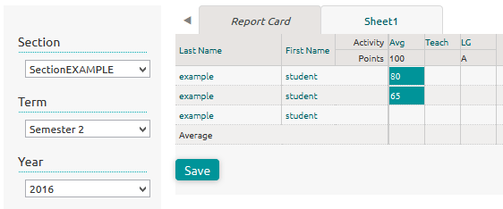
Grade/Mark Students
Select the “Section” you created earlier in area 1
Your students will be in area 2
Type students final report card marks and comments go in area 3
  Don’t forget to save!
3
1
2
4

Slide 20
Username: manager
Password: schooltool

Slide 21
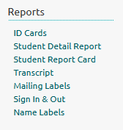
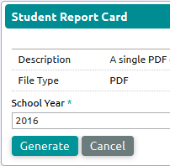
Print Report Card
Login as manager again
  Then you can print report cards
1
2
3

Slide 22
Configuring Report Cards

Slide 23
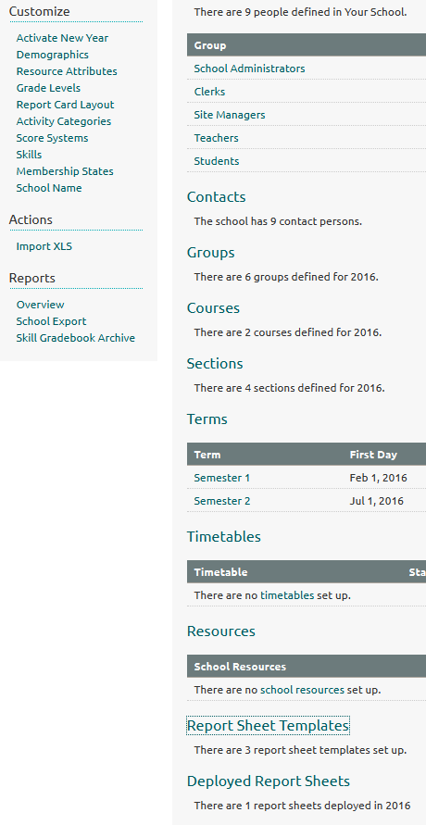
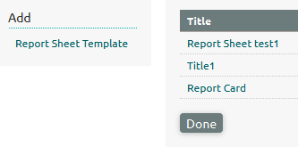
Setting Up Report Cards
3
2
1

Slide 24
Finis Nao

